Slide 1

Patch My PC and Microsoft Intune MDM

Slide 2

Part One: Patch My PC

Slide 3
Patch My PC
Third party software tool used to automate the update process of many widely used applications.
Patch My PC can be integrated with Intune or SCCM/ConfigMgr.
Patch My PC has an extensive catalog containing over 2,000 applications.
PMPC is used to update third-party apps in our environment (VLC, Mozilla Firefox, and Notepad++).

Slide 4


Why Patch My PC?
Assist with automating patching of third-party applications
Reduce risk associated with older versions
Strengthen security and compliance
Reduce overhead
Allows for custom application support with in-house applications
Vendor Support
Initial Setup
Catalog Release Changelog
Consistent Technical Support
cabarruscounty.us

Slide 5
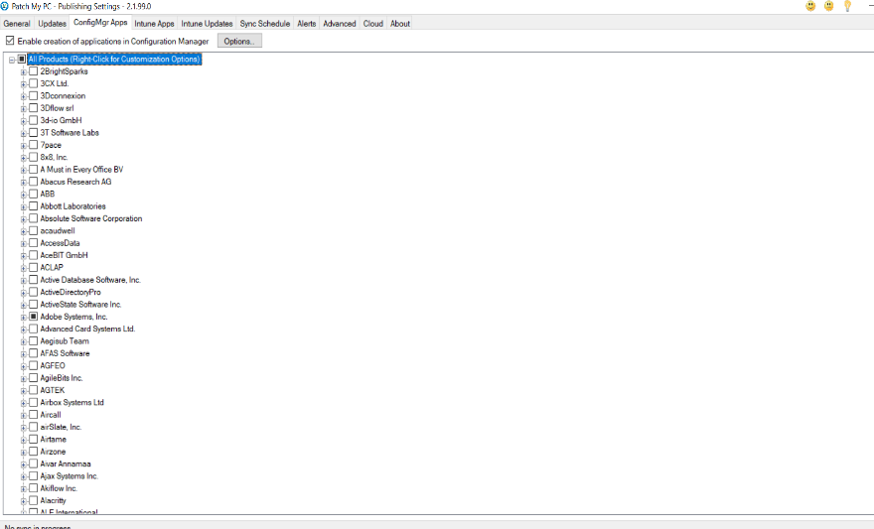
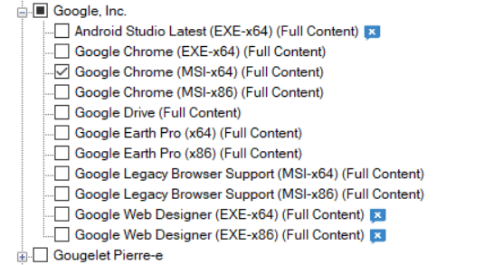
Admin Console
Publisher
Product

Slide 6
Benefits
Broader collection of third-party apps compared to standard SCCM.
Less time consuming compared to SCCM, SCCM is largely manual.
Customization: Allows for pre- or post-installation scripts.
Process Handling: Can notify users to close application before updates run with additional options to snooze/defer.
Visibility: Can scan against inventory and automatically identify applications in use.

Slide 7
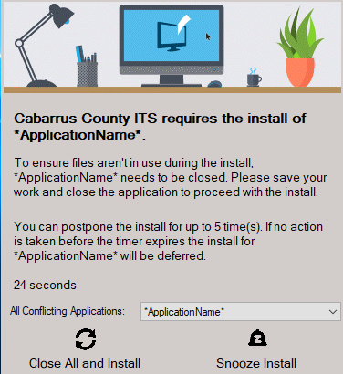
End user

Slide 8
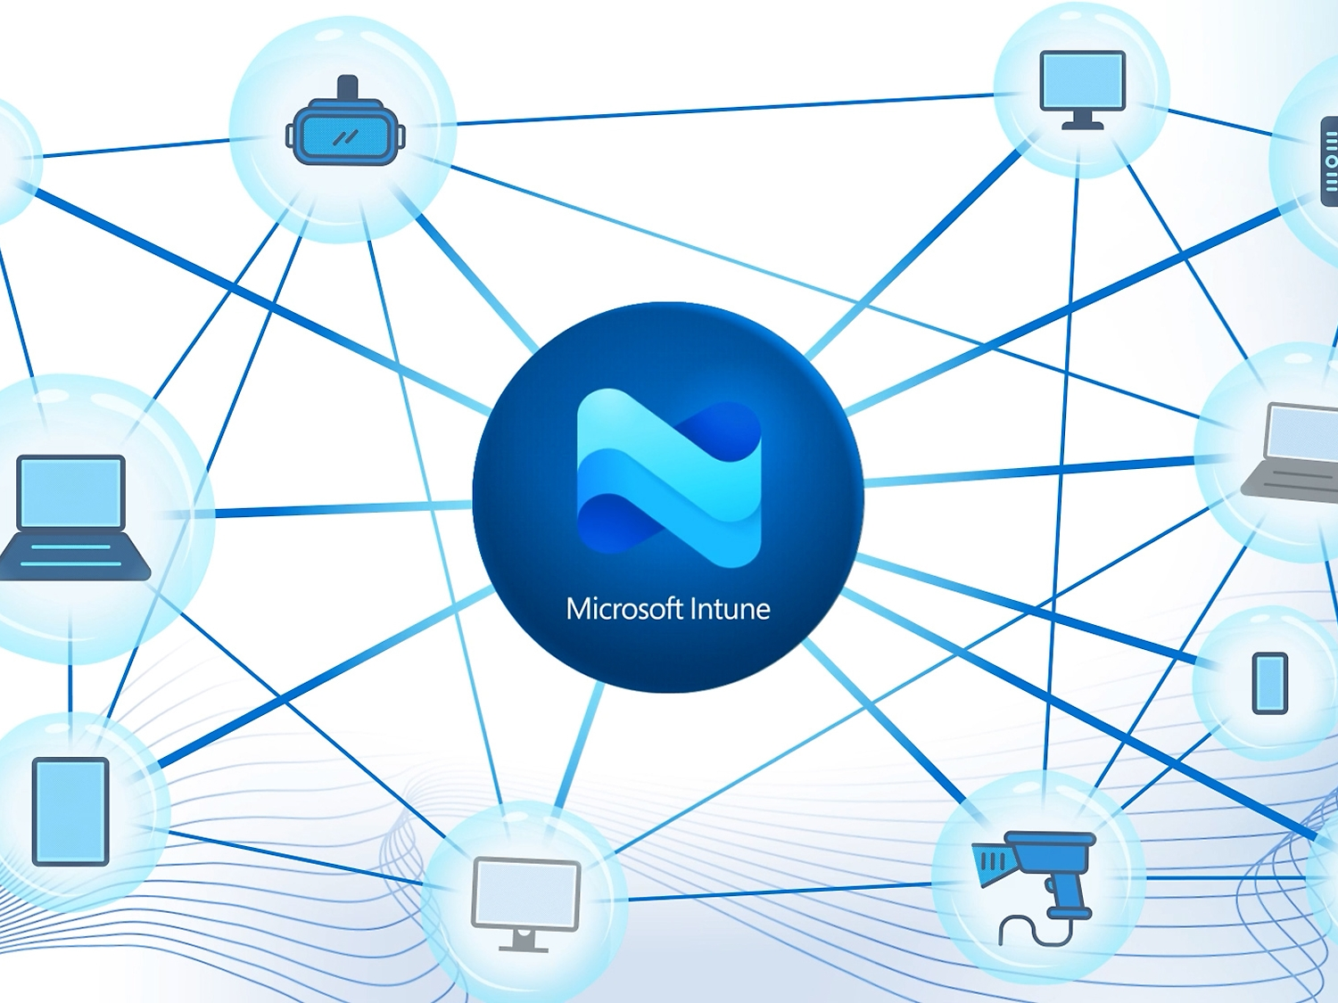
Part Two: Microsoft Intune MDM

Slide 9
What is Intune?
Intune is a product that has been developed by Microsoft to simplify MDM (mobile device management) and MAM (mobile applications management) processes.

Slide 10
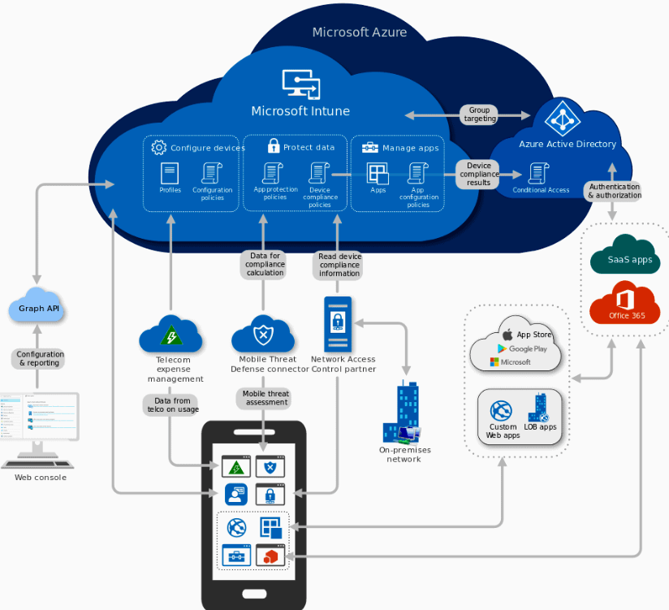
Intune Architecture Diagram

Slide 11
Benefits
Lost device assistance (location, remote wipe)
Pin resets
App deployment
Profile configuration and management
License assignment
Endpoint security
Device compliance & enrollment
Conditional access

Slide 12
